Slide 1
St. Louis Central Corridor West Building Permits
Monthly Report: October 2020

Slide 2
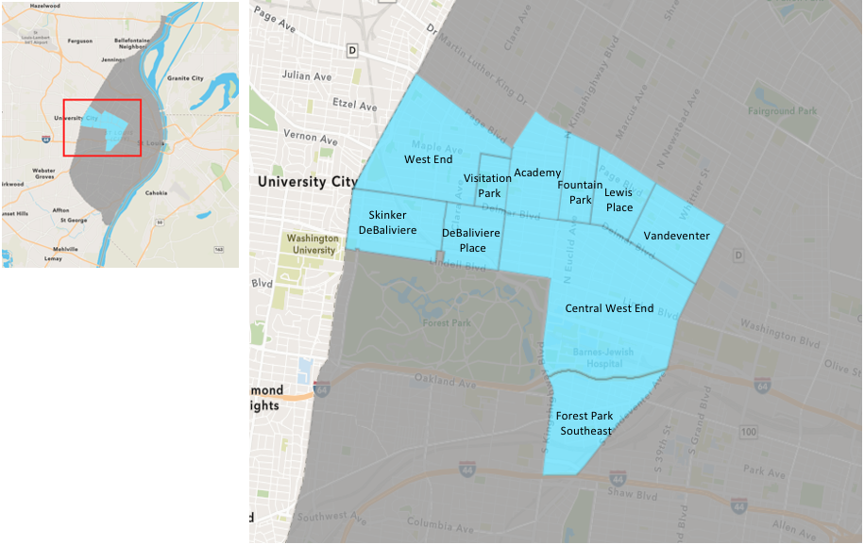
St. Louis Neighborhood Spatial Reference

Slide 3
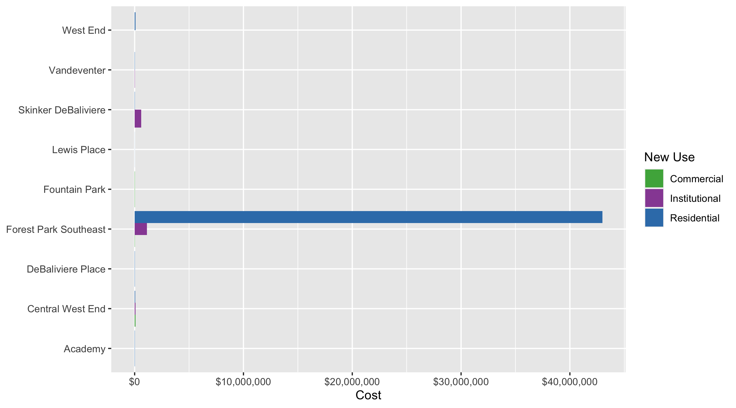
Neighborhood Summary: Average Building Permit Cost

Slide 4
Neighborhood Summary
October 2020 | October 2020 | October 2020 | October 2020
Neighborhood | Average Cost | # of Permits | Total Value of Permits
Academy | $17,418 | 5 | $87,090
Central West End | $51,923 | 39 | $2,024,979
DeBaliviere Place | $27,500 | 2 | $55,000
Forest Park Southeast | $23,495,926 | 13 | $305,447,040
Fountain Park | $30,000 | 1 | $30,000
Lewis Place | $6,500 | 1 | $6,500
Skinker DeBaliviere | $135,161 | 11 | $1,486,767
Vandeventer | $29,465 | 5 | $147,323
Visitation Park | $0 | 0 | $0
West End | $48,312 | 10 | $483,122
Last 6 Months | Last 6 Months | Last 6 Months | Last 6 Months
Neighborhood | Average Cost | # of Permits | Total Value of Permits
Academy | $21,884 | 27 | $590,860
Central West End | $406,129 | 233 | $94,628,023
DeBaliviere Place | $343,757 | 35 | $12,031,497
Forest Park Southeast | $4,350,297 | 71 | $308,871,069
Fountain Park | $62,100 | 5 | $310,500
Lewis Place | $72,251 | 11 | $794,760
Skinker DeBaliviere | $987,700 | 67 | $66,175,879
Vandeventer | $38,223 | 12 | $458,672
Visitation Park | $19,091 | 5 | $95,455
West End | $330,144 | 41 | $13,535,905

Slide 5
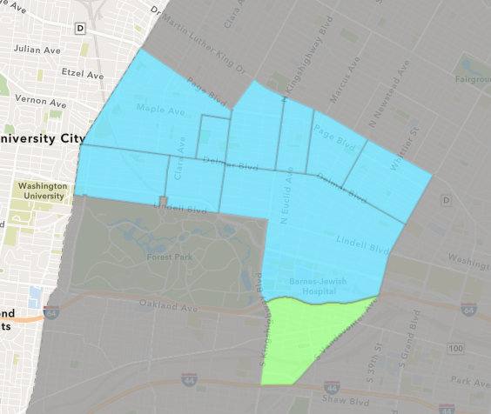
Forest Park Southeast
October 2020 Neighborhood Cost Breakdown
Mean: $23,495,926
Median: $9,400
Range: $3,000 - $300,490,140

Slide 6
Forest Park Southeast: Summary Notes
13 building permits in October 2020
-23.53% change compared to October 2019 (17 total building permits)
$23,495,926: Average building permit cost in October 2020
29205.26% change compared to October 2019 ($80,176)
106 total building permits in 2020
-29.80% change YTD compared to this time in 2019 (151 total building permits)
$2,932,702: YTD average building permit cost in 2020
1348.96% change YTD compared to this time in 2019 ($202,401)

Slide 7
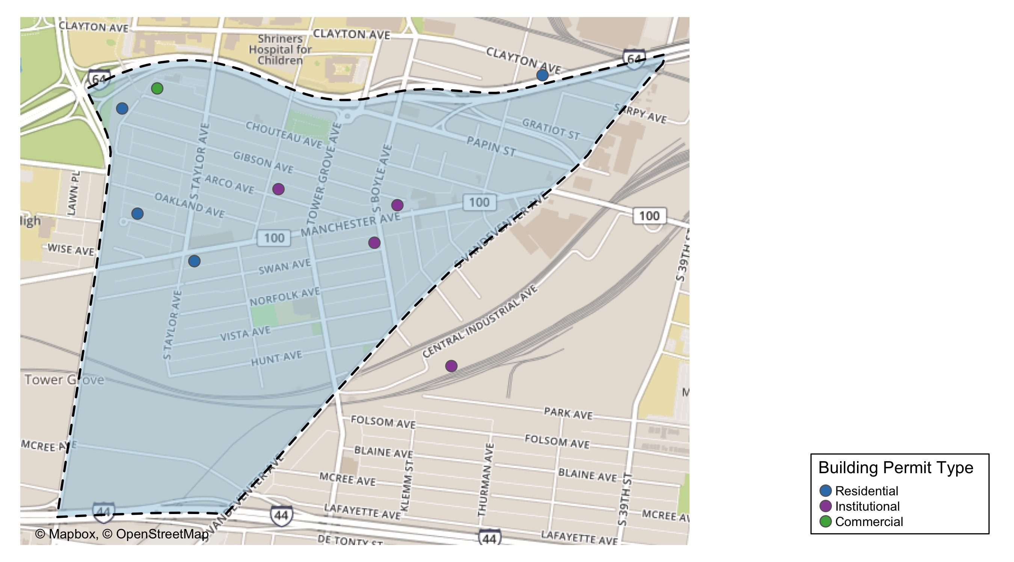
Forest Park Southeast

Slide 8
Neighborhood Summary
October 2020 | October 2020 | October 2020 | October 2020
Permit Use | Average Cost | # of Permits | Total Value of Permits
Commercial | $30,000 | 2 | $60,000
Industrial | $0 | 0 | $0
Institutional | $1,128,125 | 4 | $4,512,500
Residential | $42,982,077 | 7 | $300,874,540
Last 6 Months | Last 6 Months | Last 6 Months | Last 6 Months
Permit Use | Average Cost | # of Permits | Total Value of Permits
Commercial | $53,777 | 13 | $699,100
Industrial | $267,033 | 3 | $801,100
Institutional | $506,777 | 9 | $4,560,989
Residential | $6,582,823 | 46 | $302,809,880

Slide 9
Forest Park Southeast Individual Permit Breakdown
Owner | New Use | Cost | address
FARRELL, BRIAN | Residential | $9,000 | 4335 SWAN AV
FARRELL, BRIAN | Residential | $6,000 | 4335 SWAN AV
HEAGNEY, PHILIP | Residential | $45,000 | 4541 GIBSON AV
4248 MANCHESTER LLC | Institutional | $3,500 | 4248 MANCHESTER AV
CENCORE CAPITAL LLC | Residential | $310,000 | 4330 VISTA AV
GS CHROMA PH LLC | Residential | $5,000 | 900 S SARAH ST
TCF INVESTMENTS LLC | Institutional | $3,000 | 1039 TOWER GROVE AV
JCAT HOLDINGS LLC | Commercial | $25,000 | 4501-07 CHOUTEAU AV
PK REAL ESTATE LLC | Institutional | $6,000 | 4337 MANCHESTER AV
BRACKEN, ANDREW | Residential | $9,400 | 4521 WICHITA AV
FOREST PARK SOUTHEAST | Commercial | $35,000 | 4143 MANCHESTER AV
GREEN STREET SWAN INVESTORS LLC | Residential | $300,490,140 | 4500-4540 SWAN AV
GREEN ST 4565 MCREE INVESTORS LLC | Institutional | $4,500,000 | 4565 MCREE AV

Slide 10
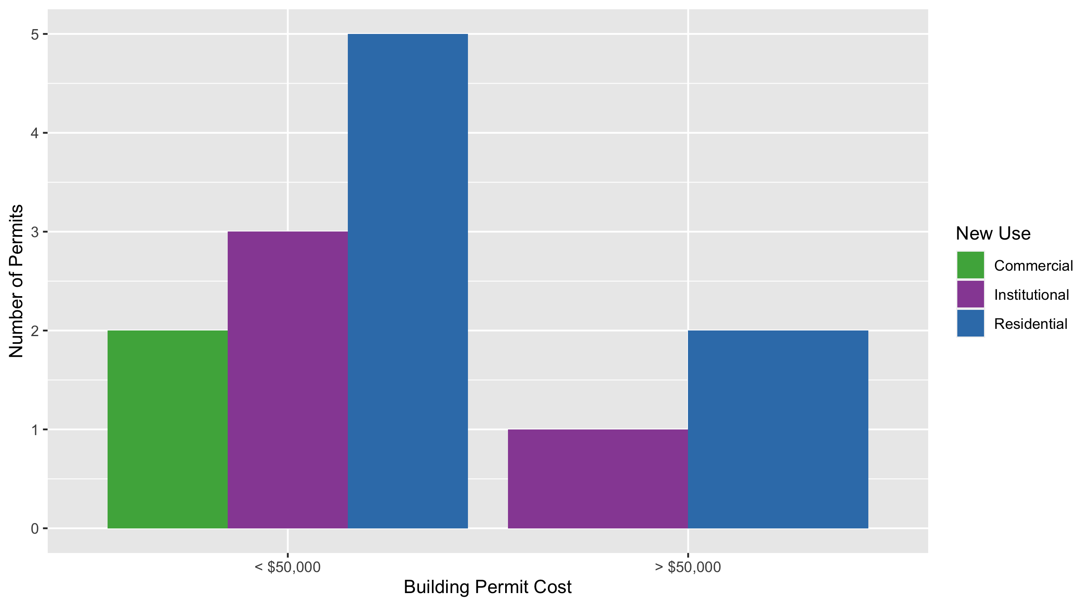
Forest Park Southeast Permit Cost Breakdown

Slide 11
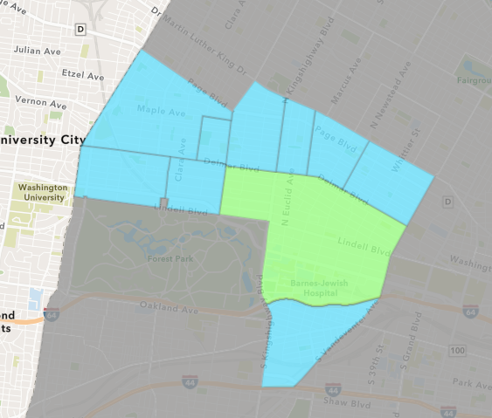
Central West End
October 2020 Neighborhood Cost Breakdown
Mean: $51,923
Median: $11,945
Range: $500 - $428,000

Slide 12
Central West End: Summary Notes
39 building permits in October 2020
-23.53% change compared to October 2019 (51 total building permits)
$51,923: Average building permit cost in October 2020
-74.78% change compared to October 2019 ($205,901)
367 total building permits in 2020
-10.49% change YTD compared to this time in 2019 (410 total building permits)
$368,299: YTD average building permit cost in 2020
64.35% change YTD compared to this time in 2019 ($224,098)

Slide 13
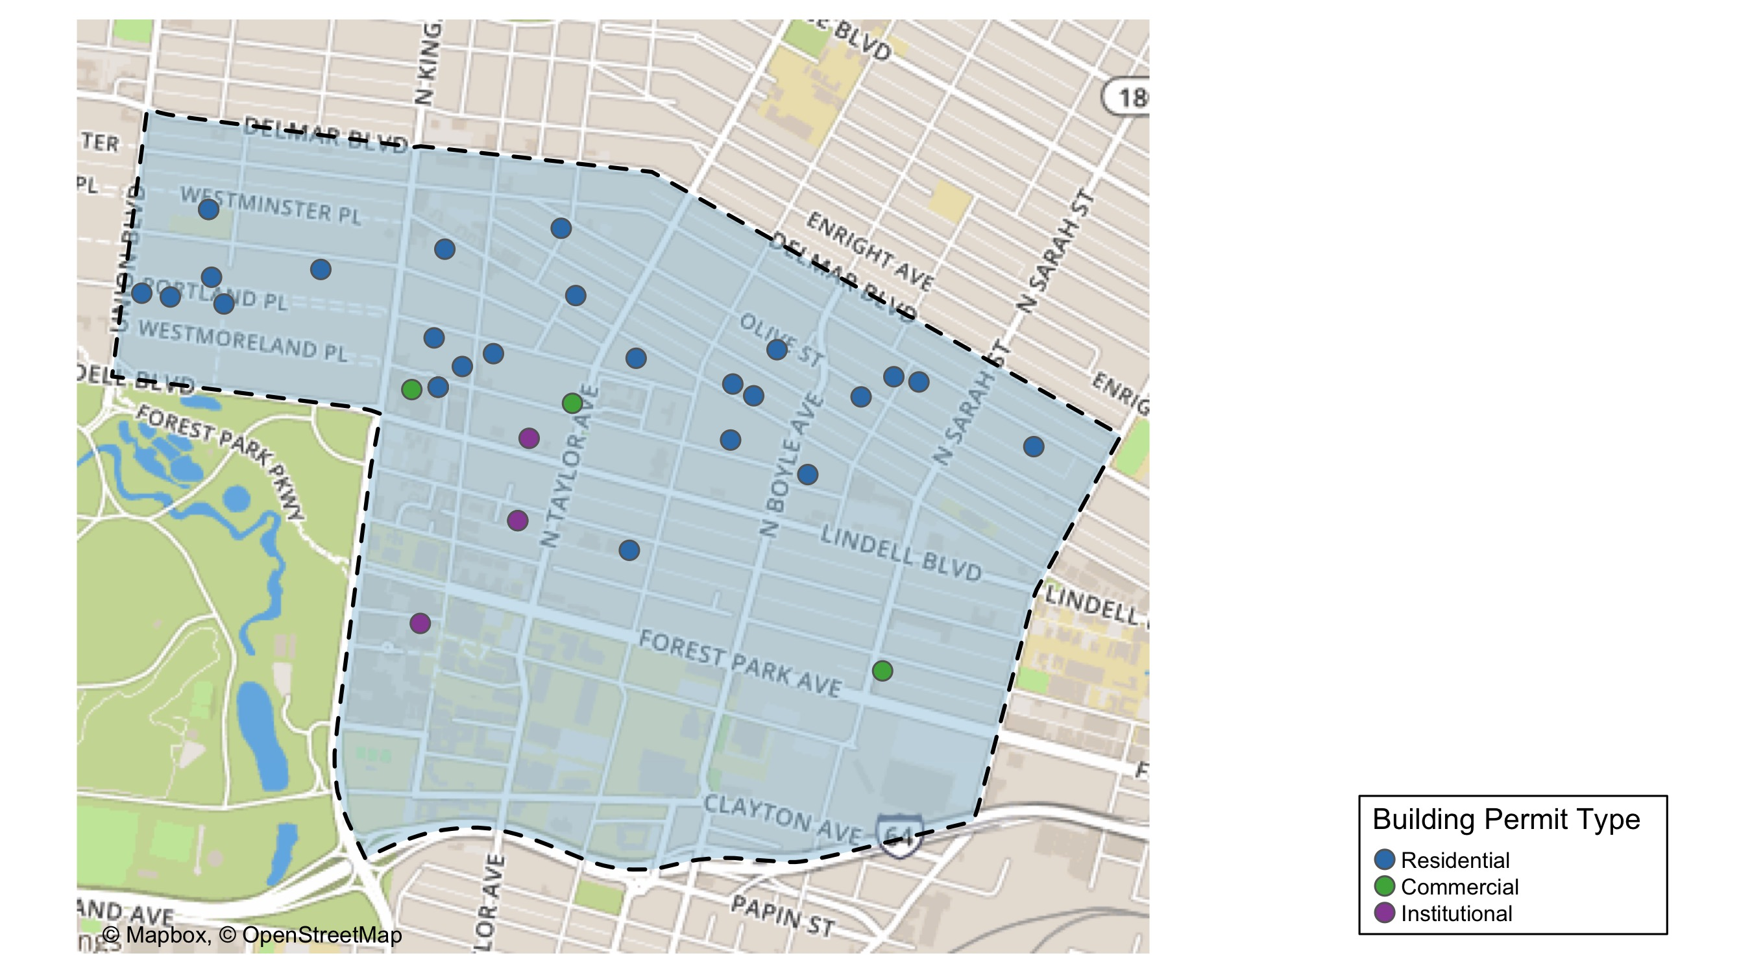
Central West End

Slide 14
Central West End
October 2020 | October 2020 | October 2020 | October 2020
Permit Use | Average Cost | # of Permits | Total Value of Permits
Commercial | $69,400 | 4 | $277,600
Industrial | $0 | 0 | $0
Institutional | $74,220 | 7 | $519,537
Residential | $43,852 | 28 | $1,227,842
Last 6 Months | Last 6 Months | Last 6 Months | Last 6 Months
Permit Use | Average Cost | # of Permits | Total Value of Permits
Commercial | $74,302 | 37 | $2,749,165
Industrial | $20,000 | 1 | $20,000
Institutional | $650,702 | 68 | $44,247,712
Residential | $374,891 | 127 | $47,611,146

Slide 15
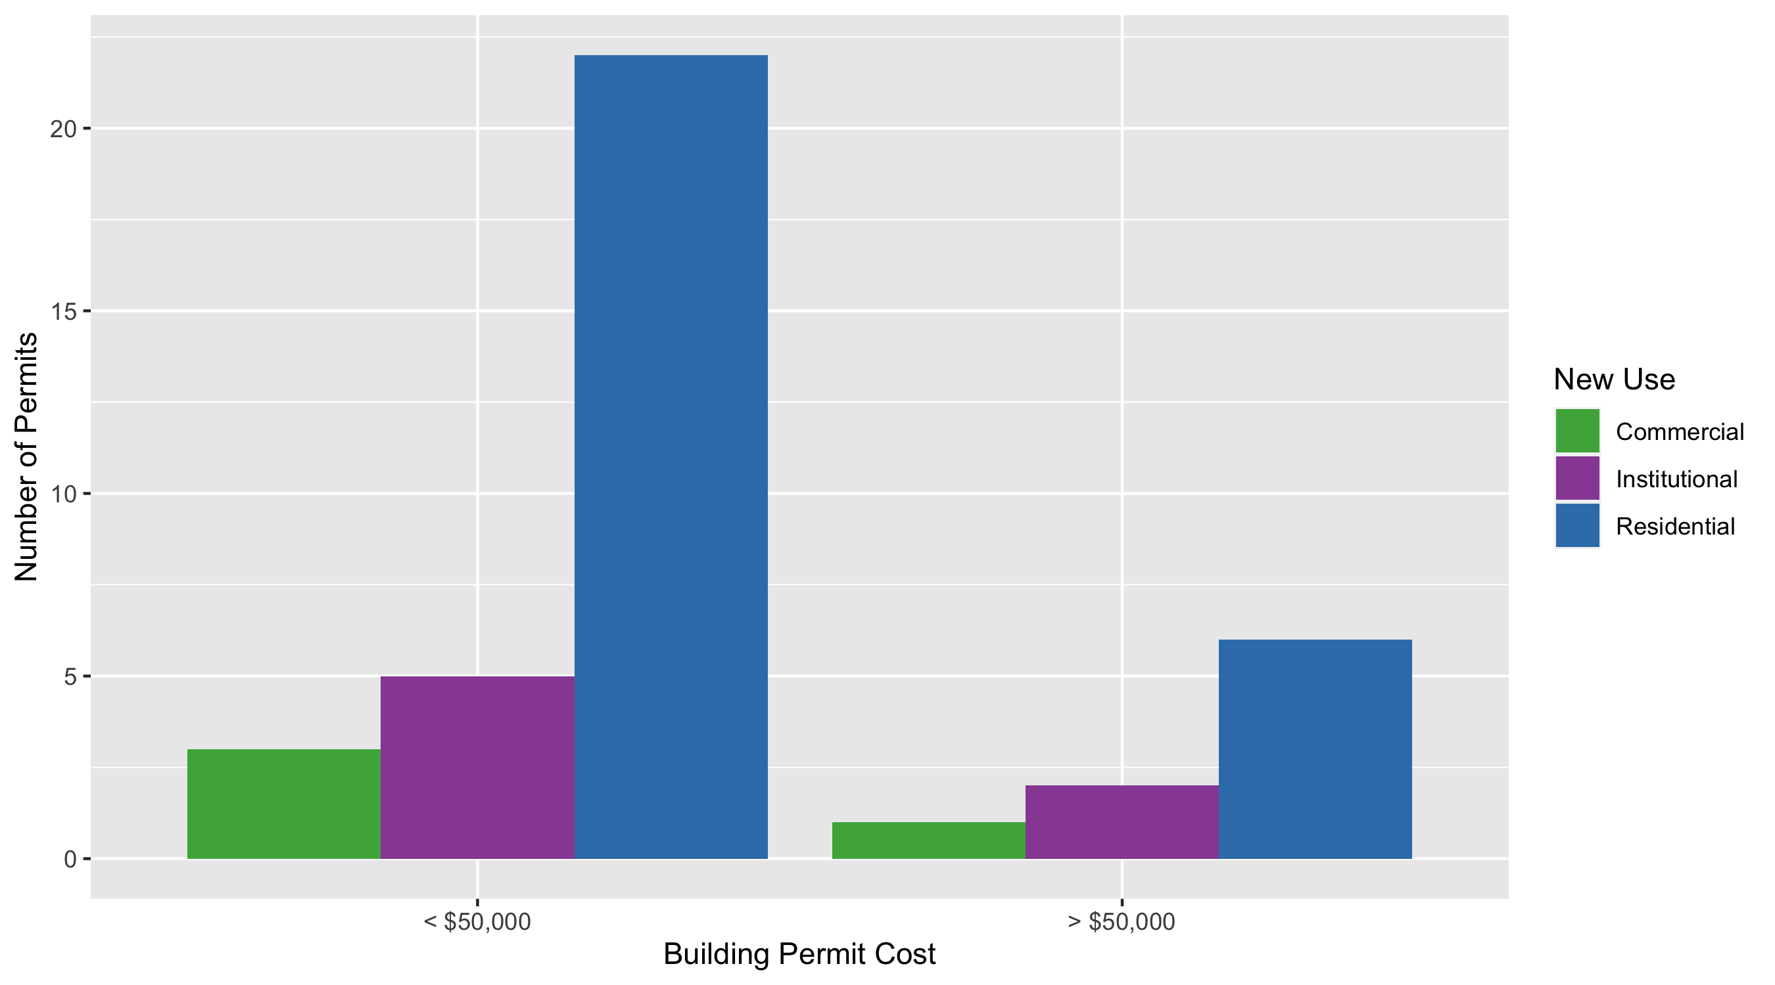
Cental West End Permit Cost Breakdown

Slide 16
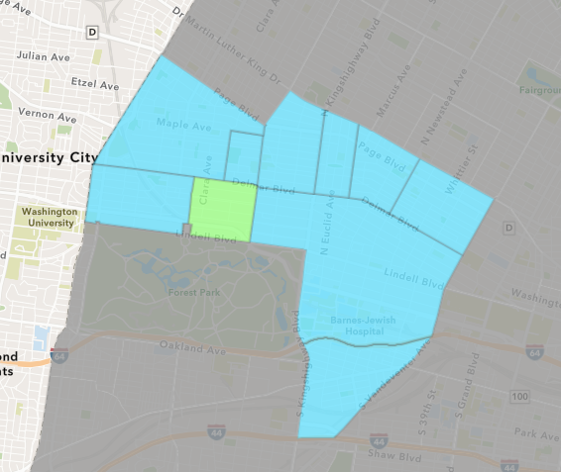
DeBaliviere Place
October 2020 Neighborhood Cost Breakdown
Mean: $27,500
Median: $27,500
Range: $15,000 - $40,000

Slide 17
DeBaliviere Place: Summary Notes
2 building permits in October 2020
-75.00% change compared to October 2019 (8 total building permits)
$27,500: Average building permit cost in October 2020
-32.04% change compared to October 2019 ($40,464)
48 total building permits in 2020
-2.04% change YTD compared to this time in 2019 (49 total building permits)
$691,407: YTD average building permit cost in 2020
1228.99% change YTD compared to this time in 2019 ($52,025)

Slide 18
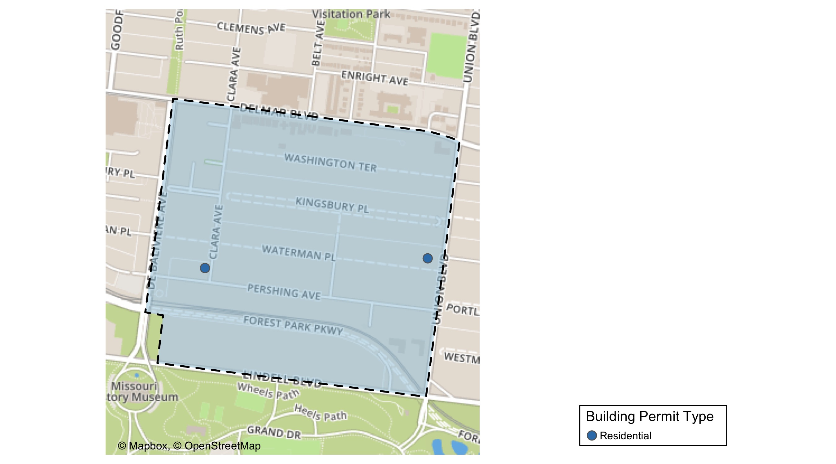
DeBaliviere Place

Slide 19
DeBaliviere Place
October 2020 | October 2020 | October 2020 | October 2020
Permit Use | Average Cost | # of Permits | Total Value of Permits
Commercial | $0 | 0 | $0
Industrial | $0 | 0 | $0
Institutional | $0 | 0 | $0
Residential | $27,500 | 2 | $55,000
Last 6 Months | Last 6 Months | Last 6 Months | Last 6 Months
Permit Use | Average Cost | # of Permits | Total Value of Permits
Commercial | $780 | 1 | $780
Industrial | $0 | 0 | $0
Institutional | $400 | 1 | $400
Residential | $364,555 | 33 | $12,030,317

Slide 20
DeBaliviere Place Individual Permit Breakdown
Owner | New Use | Cost | Address
RICHARDSON, GERALD M & JEAN E CHOUQU | Residential | $15,000 | 4 KINGSBURY PL
RAINIER ONE LLC ASPRIENT PROPERTIES | Residential | $40,000 | 5539 PERSHING AV

Slide 21
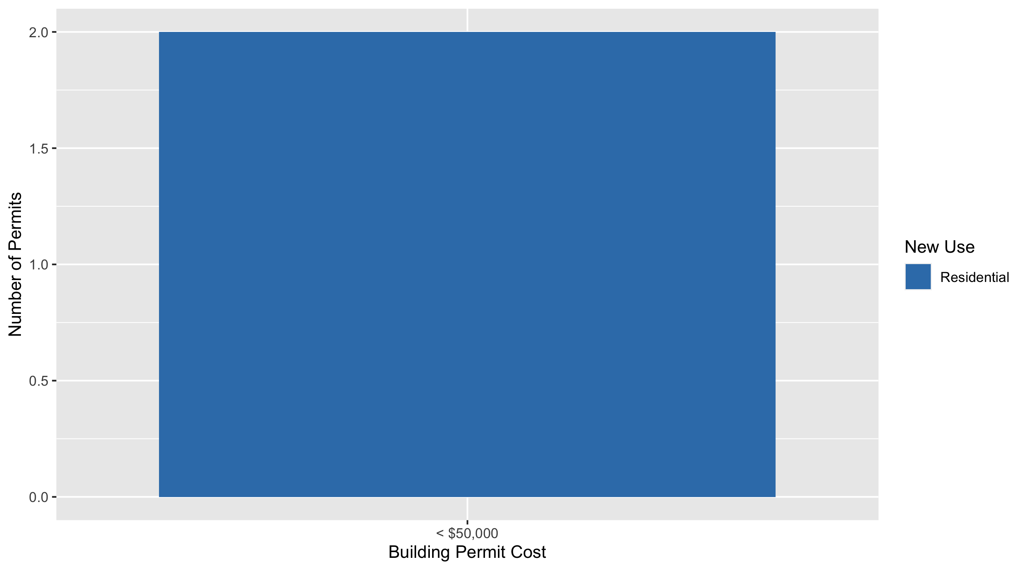
DeBaliviere Place Permit Cost Breakdown

Slide 22
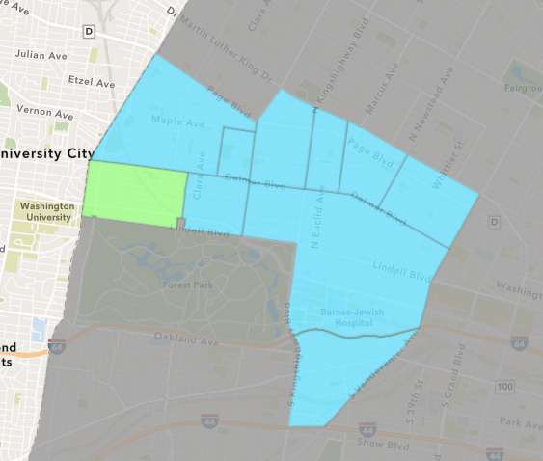
Skinker DeBaliviere
October 2020 Neighborhood Cost Breakdown
Mean: $135,161
Median: $20,000
Range: $4,399 - $1,186,000

Slide 23
Skinker DeBaliviere: Summary Notes
11 building permits in October 2020
10.00% change compared to October 2019 (10 total building permits)
$135,161: Average building permit cost in October 2020
890.94% change compared to October 2019 ($13,640)
110 total building permits in 2020
80.33% change YTD compared to this time in 2019 (61 total building permits)
$609,526: YTD average building permit cost in 2020
2847.51% change YTD compared to this time in 2019 ($20,679)

Slide 24
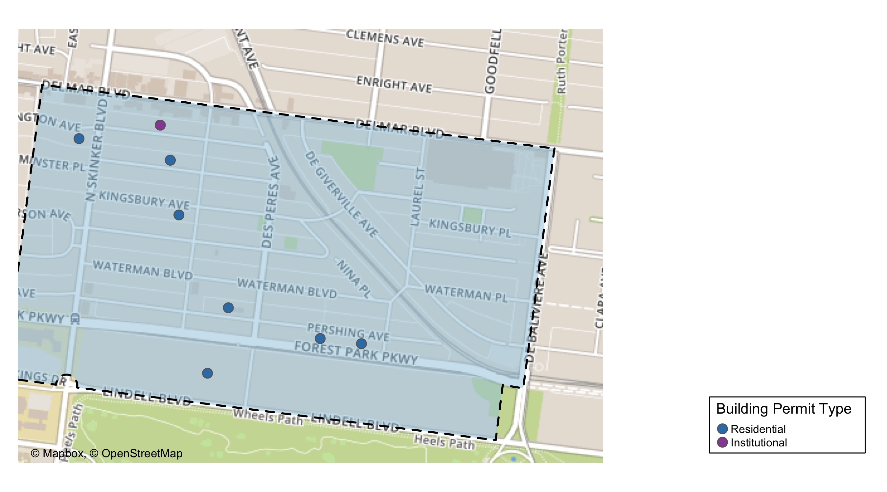
Skinker DeBaliviere

Slide 25
Skinker DeBaliviere
October 2020 | October 2020 | October 2020 | October 2020
Permit Use | Average Cost | # of Permits | Total Value of Permits
Commercial | $0 | 0 | $0
Industrial | $0 | 0 | $0
Institutional | $613,800 | 2 | $1,227,601
Residential | $28,796 | 9 | $259,166
Last 6 Months | Last 6 Months | Last 6 Months | Last 6 Months
Permit Use | Average Cost | # of Permits | Total Value of Permits
Commercial | $5,707,290 | 10 | $57,072,898
Industrial | $0 | 0 | $0
Institutional | $622,267 | 6 | $3,733,601
Residential | $105,282 | 51 | $5,369,380

Slide 26
Skinker DeBaliviere Individual Permit Breakdown
Owner | New Use | Cost | Address
CHURCH BUILDING LLC | Institutional | $1,186,000 | 6166 DELMAR BLVD
BRINKLEY, CYNTHIA J | Residential | $70,000 | 5795 LINDELL BLVD
HAWKINS, EMILY & | Residential | $5,000 | 6152 WASHINGTON AV
BRISCO, BETHANY A & ANDREW F CAWOOD | Residential | $20,000 | 6223 WASHINGTON AV
CHURCH BUILDING LLC JOE EDWARDS | Institutional | $41,601 | 6160 DELMAR BLVD
RUTLAND, JONATHAN & JOHN ALLEN | Residential | $9,267 | 5948 PERSHING AV
HAWKINS, ROOSEVELT JR & LAURA | Residential | $4,399 | 5908 PERSHING AV
LIBERMAN, DENISE D & R SCOTT GRANNEM | Residential | $5,500 | 6045-47 WATERMAN BLVD
HAWKINS, EMILY & THOMAS WEESEI | Residential | $20,000 | 6152 WASHINGTON AV
KURTZ, PAUL B & KATHERINE N | Residential | $25,000 | 6178 KINGSBURY AV
DUNN, ROBERT C III & MARY C TRS | Residential | $100,000 | 6055 LINDELL BLVD

Slide 27
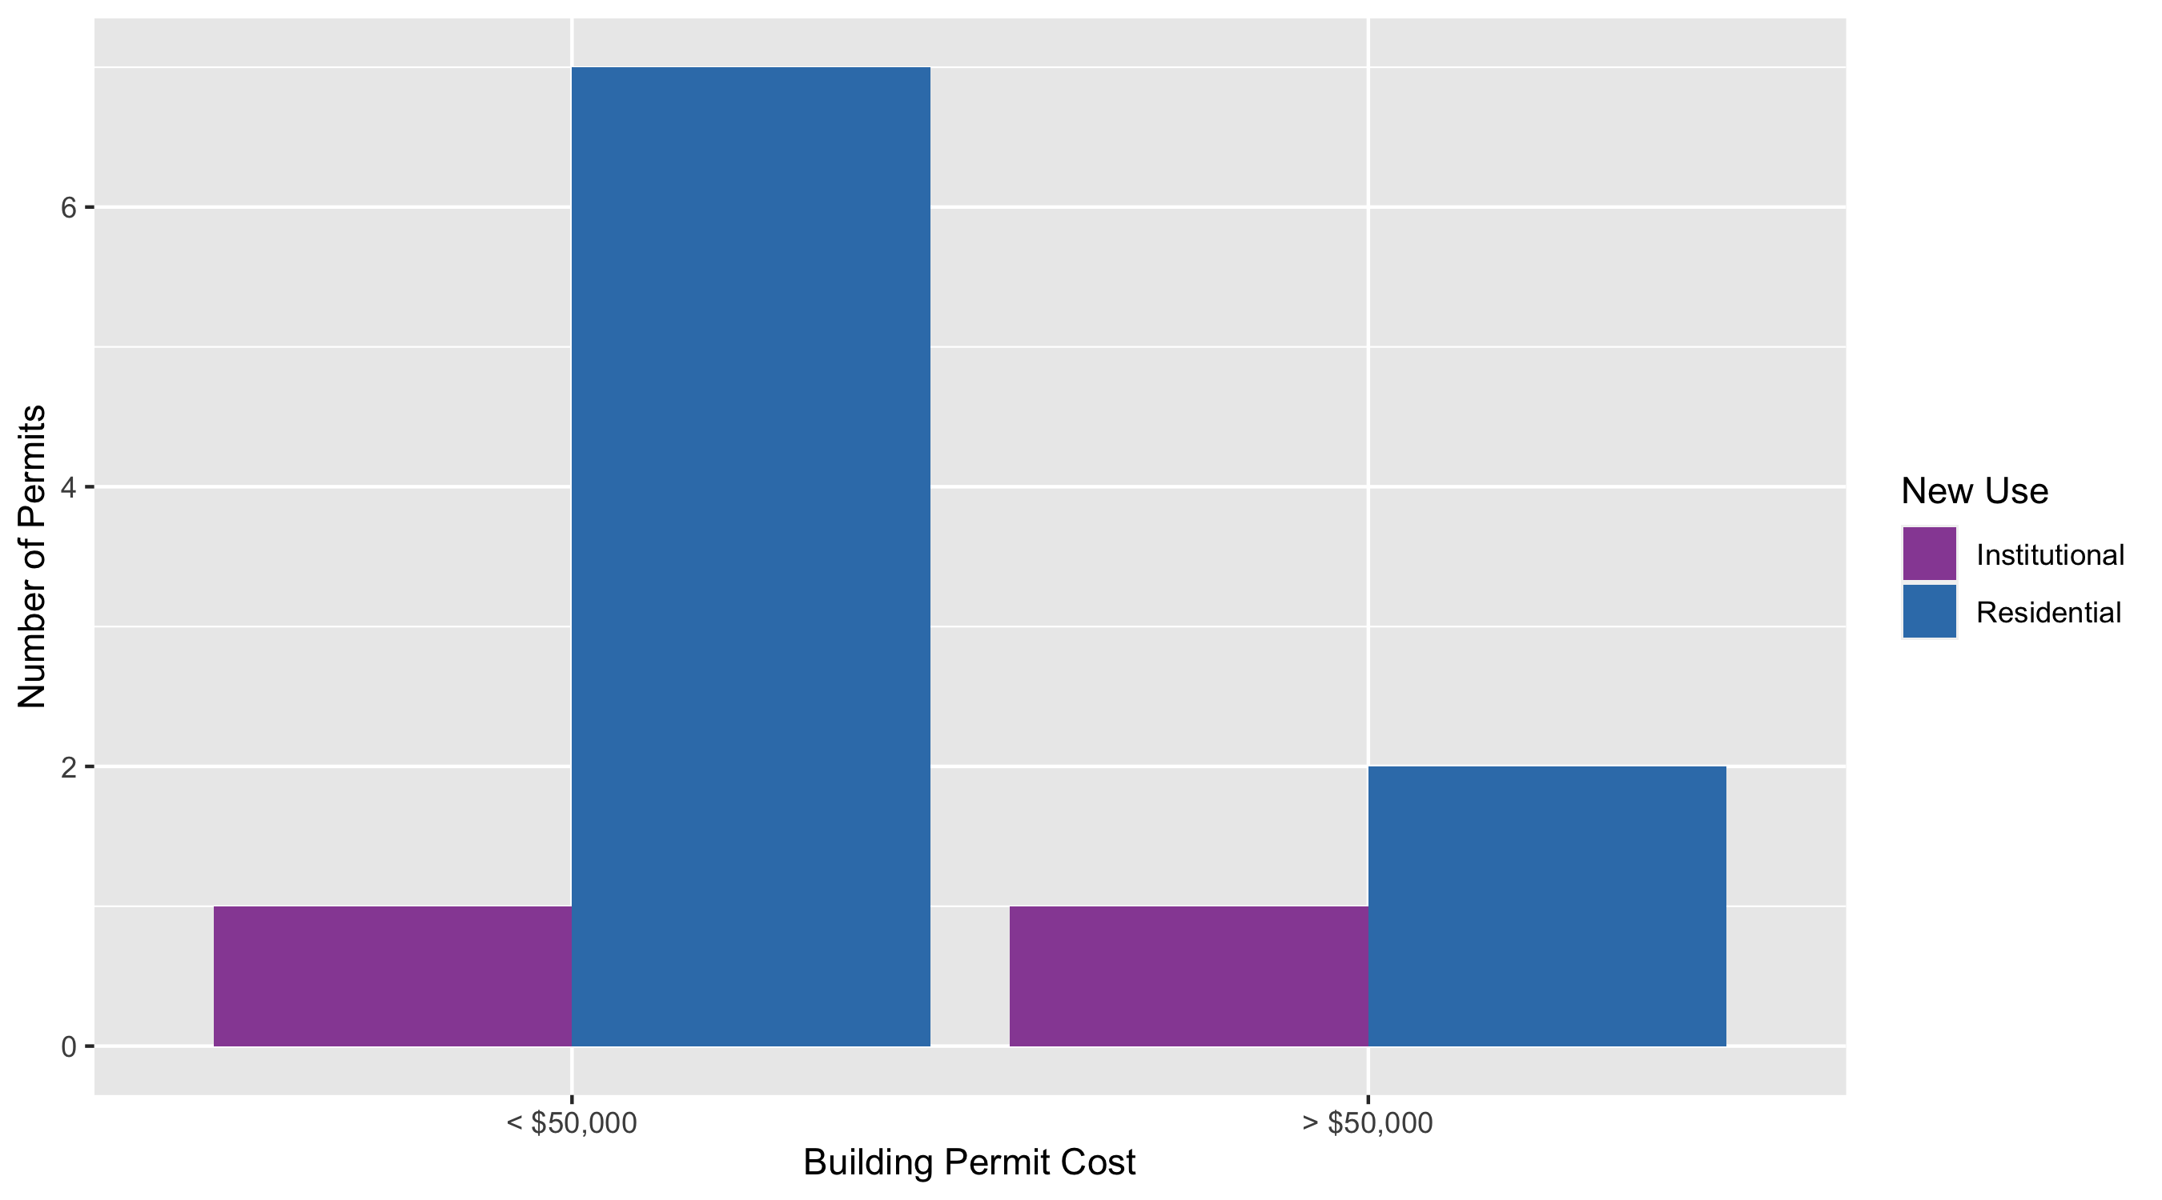
Skinker DeBaliviere Permit Cost Breakdown

Slide 28
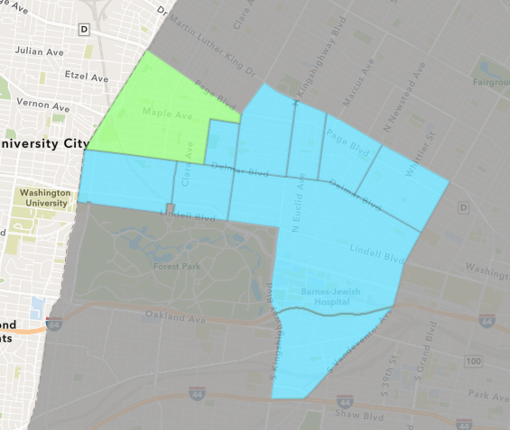
West End
October 2020 Neighborhood Cost Breakdown
Mean: $48,312
Median: $1,075
Range: $666 - $450,000

Slide 29
West End: Summary Notes
10 building permits in October 2020
150.00% change compared to October 2019 (4 total building permits)
$48,312: Average building permit cost in October 2020
799.08% change compared to October 2019 ($5,374)
67 total building permits in 2020
59.52% change YTD compared to this time in 2019 (42 total building permits)
$357,243: YTD average building permit cost in 2020
198.24% change YTD compared to this time in 2019 ($119,782)

Slide 30
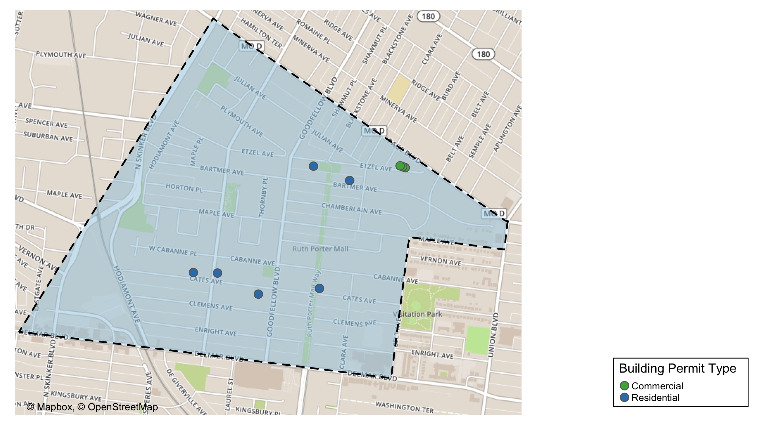
West End

Slide 31
West End
October 2020 | October 2020 | October 2020 | October 2020
Permit Use | Average Cost | # of Permits | Total Value of Permits
Commercial | $787 | 4 | $3,148
Industrial | $0 | 0 | $0
Institutional | $0 | 0 | $0
Residential | $79,996 | 6 | $479,974
Last 6 Months | Last 6 Months | Last 6 Months | Last 6 Months
Permit Use | Average Cost | # of Permits | Total Value of Permits
Commercial | $1,926 | 7 | $13,480
Industrial | $0 | 0 | $0
Institutional | $521,018 | 2 | $1,042,035
Residential | $390,012 | 32 | $12,480,390

Slide 32
West End Individual Permit Breakdown
Owner | New Use | Cost | Address
GIBSON, KARLA | Residential | $3,974 | 5895 CATES AV
PAGEANT BUILDING LLC | Commercial | $1,150 | 6161 DELMAR BLVD
SANDERS, TORRE | Residential | $1,000 | 5641 CATES AV
CARADINE, LAVELLE JR | Residential | $18,000 | 5728 ETZEL AV
LAND CLEARANCE FOR REDEVELOPMENT | Commercial | $666 | 5537-39 ETZEL AV
LRA | Commercial | $666 | 5543 ETZEL AV
LRA | Commercial | $666 | 5545 ETZEL AV
MASTIN, DAVID & NANCY | Residential | $450,000 | 5890 CATES AV
HENNING, AARON & CAREN | Residential | $6,000 | 5615 BARTMER AV
TAYLOR, DANIEAL Y | Residential | $1,000 | 5936-8 WEST CABANNE PL

Slide 33
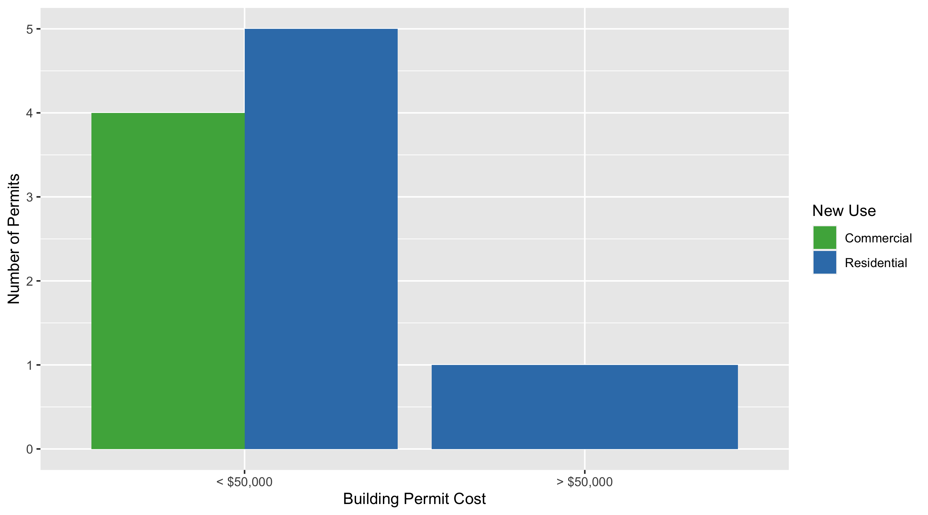
West End Permit Cost Breakdown

Slide 34
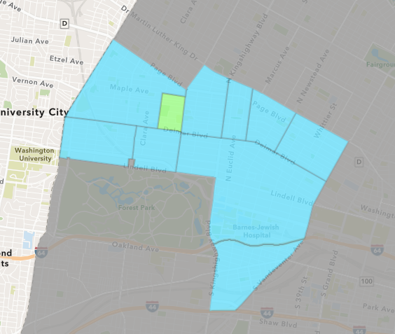
Visitation Park
October 2020 Neighborhood Cost Breakdown
Mean: $0
Median: NA
Range: $0 - $0

Slide 35
Visitation Park: Summary Notes
0 building permits in October 2020
0.00% change compared to October 2019 (0 total building permits)
$0: Average building permit cost in October 2020
0.00% change compared to October 2019 ($0)
6 total building permits in 2020
500.00% change YTD compared to this time in 2019 (1 total building permits)
$18,242: YTD average building permit cost in 2020
128.03% change YTD compared to this time in 2019 ($8,000)

Slide 36
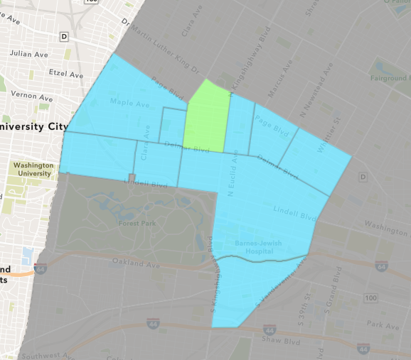
Academy
October 2020 Neighborhood Cost Breakdown
Mean: $17,418
Median: $4,000
Range: $1,000 - $75,000

Slide 37
Academy: Summary Notes
5 building permits in October 2020
Infinite change compared to October 2019 (0 total building permits)
$17,418: Average building permit cost in October 2020
Infinite change compared to October 2019 ($0)
40 total building permits in 2020
33.33% change YTD compared to this time in 2019 (30 total building permits)
$41,370: YTD average building permit cost in 2020
-27.08% change YTD compared to this time in 2019 ($56,735)

Slide 38
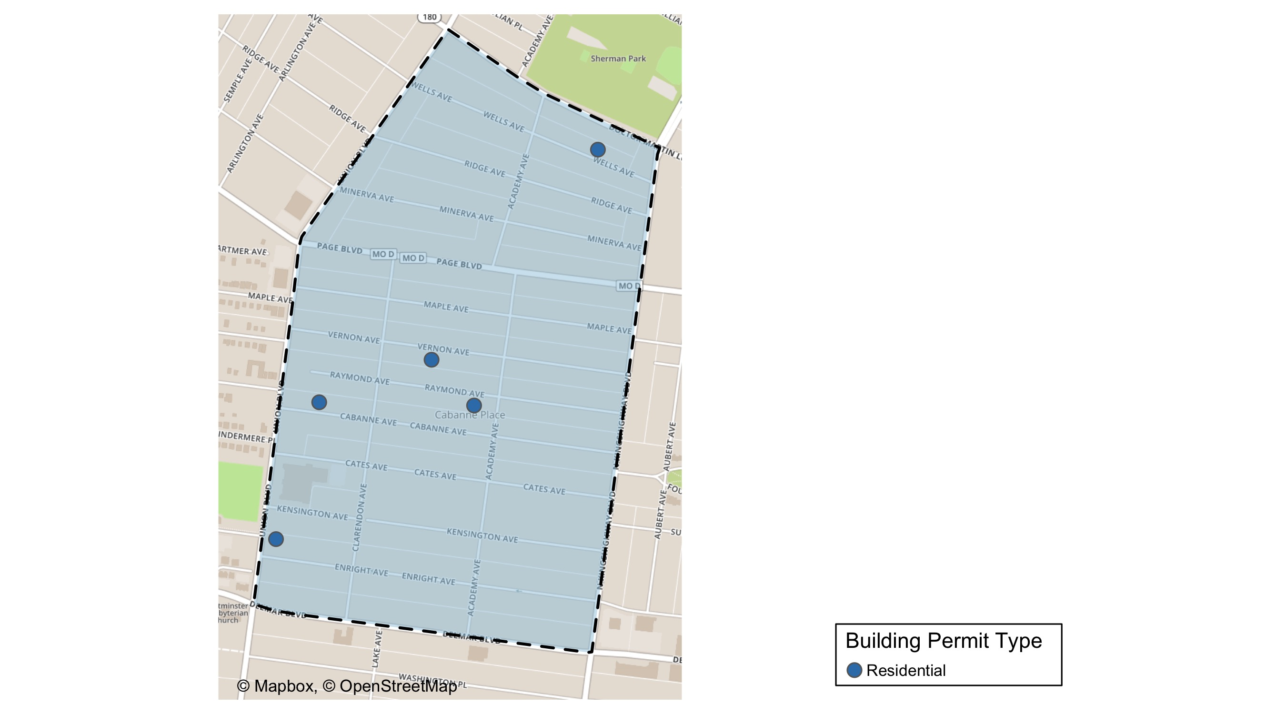
Academy

Slide 39
Academy
October 2020 | October 2020 | October 2020 | October 2020
Permit Use | Average Cost | # of Permits | Total Value of Permits
Commercial | $0 | 0 | $0
Industrial | $0 | 0 | $0
Institutional | $0 | 0 | $0
Residential | $17,418 | 5 | $87,090
Last 6 Months | Last 6 Months | Last 6 Months | Last 6 Months
Permit Use | Average Cost | # of Permits | Total Value of Permits
Commercial | $10,000 | 1 | $10,000
Industrial | $0 | 0 | $0
Institutional | $27,500 | 2 | $55,000
Residential | $21,911 | 24 | $525,860

Slide 40
Academy Individual Permit Breakdown
Owner | New Use | Cost | Address
FLAIZ, JOHN C/O GERALD MAURICE RANKI | Residential | $3,000 | 5179 CABANNE AV
ROBERTSON, LINDA J | Residential | $4,090 | 5186 RAYMOND AV
HAMILTON, RHONADA | Residential | $75,000 | 5218 RAYMOND AV
BRANTLEY, RONALD L | Residential | $4,000 | 5043 WELLS AV
SYMS, MELBA DEE JOHNSON | Residential | $1,000 | 5217 ENRIGHT AV

Slide 41
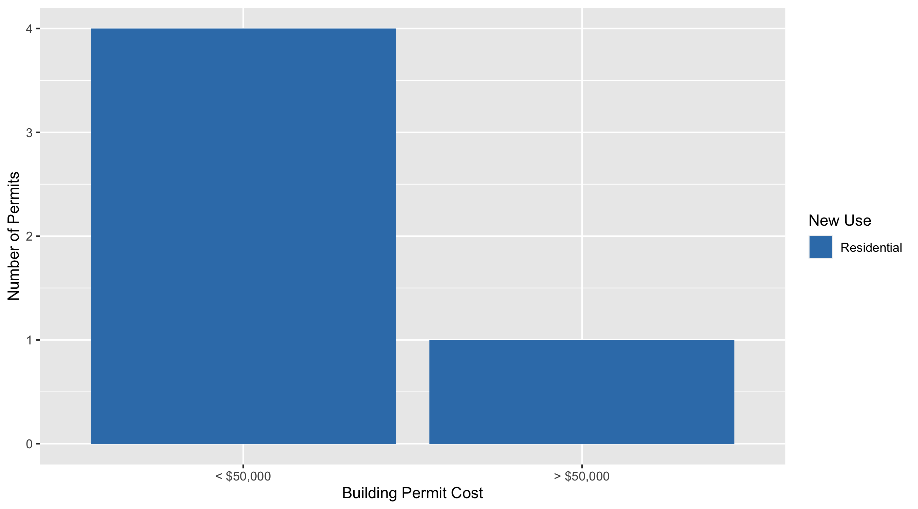
Academy Permit Cost Breakdown

Slide 42
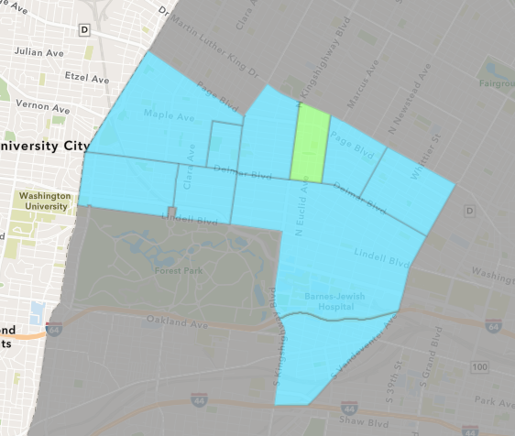
Fountain Park
October 2020 Neighborhood Cost Breakdown
Mean: $30,000
Median: $30,000
Range: $30,000 - $30,000

Slide 43
Fountain Park: Summary Notes
1 building permits in October 2020
0.00% change compared to October 2019 (1 total building permits)
$30,000: Average building permit cost in October 2020
0.00% change compared to October 2019 ($30,000)
7 total building permits in 2020
-22.22% change YTD compared to this time in 2019 (9 total building permits)
$44,786: YTD average building permit cost in 2020
37.96% change YTD compared to this time in 2019 ($32,463)

Slide 44
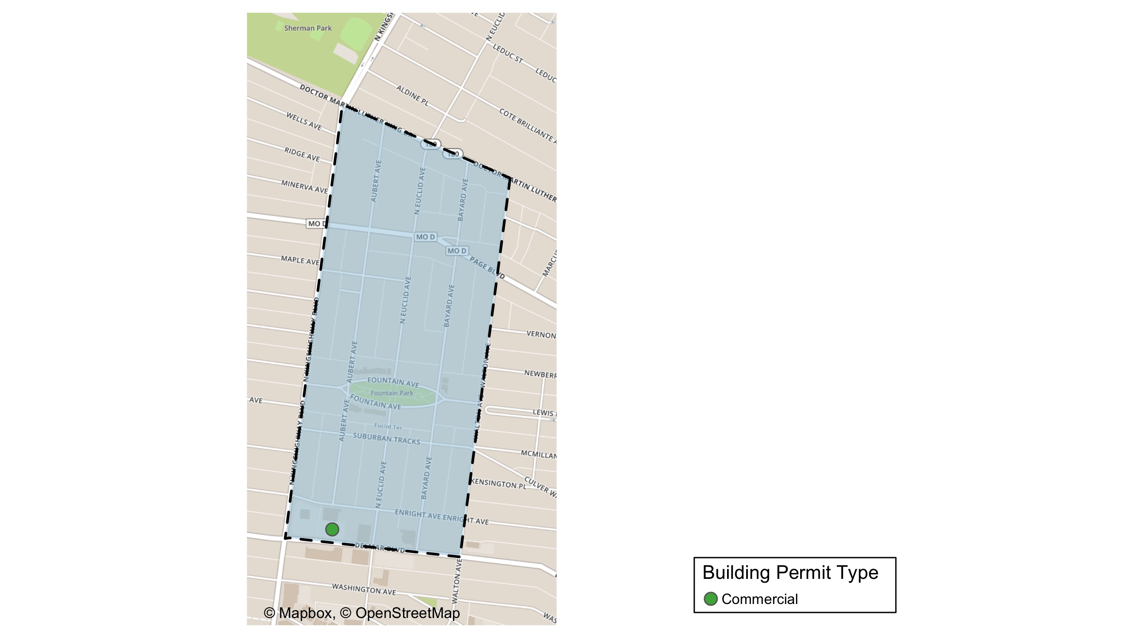
Fountain Park

Slide 45
Fountain Park
October 2020 | October 2020 | October 2020 | October 2020
Permit Use | Average Cost | # of Permits | Total Value of Permits
Commercial | $30,000 | 1 | $30,000
Industrial | $0 | 0 | $0
Institutional | $0 | 0 | $0
Residential | $0 | 0 | $0
Last 6 Months | Last 6 Months | Last 6 Months | Last 6 Months
Permit Use | Average Cost | # of Permits | Total Value of Permits
Commercial | $30,000 | 1 | $30,000
Industrial | $0 | 0 | $0
Institutional | $0 | 0 | $0
Residential | $70,125 | 4 | $280,500

Slide 46
Fountain Park Individual Permit Breakdown
Owner | New Use | Cost | Address
ROOSEVELT TOWNE LTD PARTNERSHIP C/O | Commercial | $30,000 | 701 N EUCLID AV

Slide 47
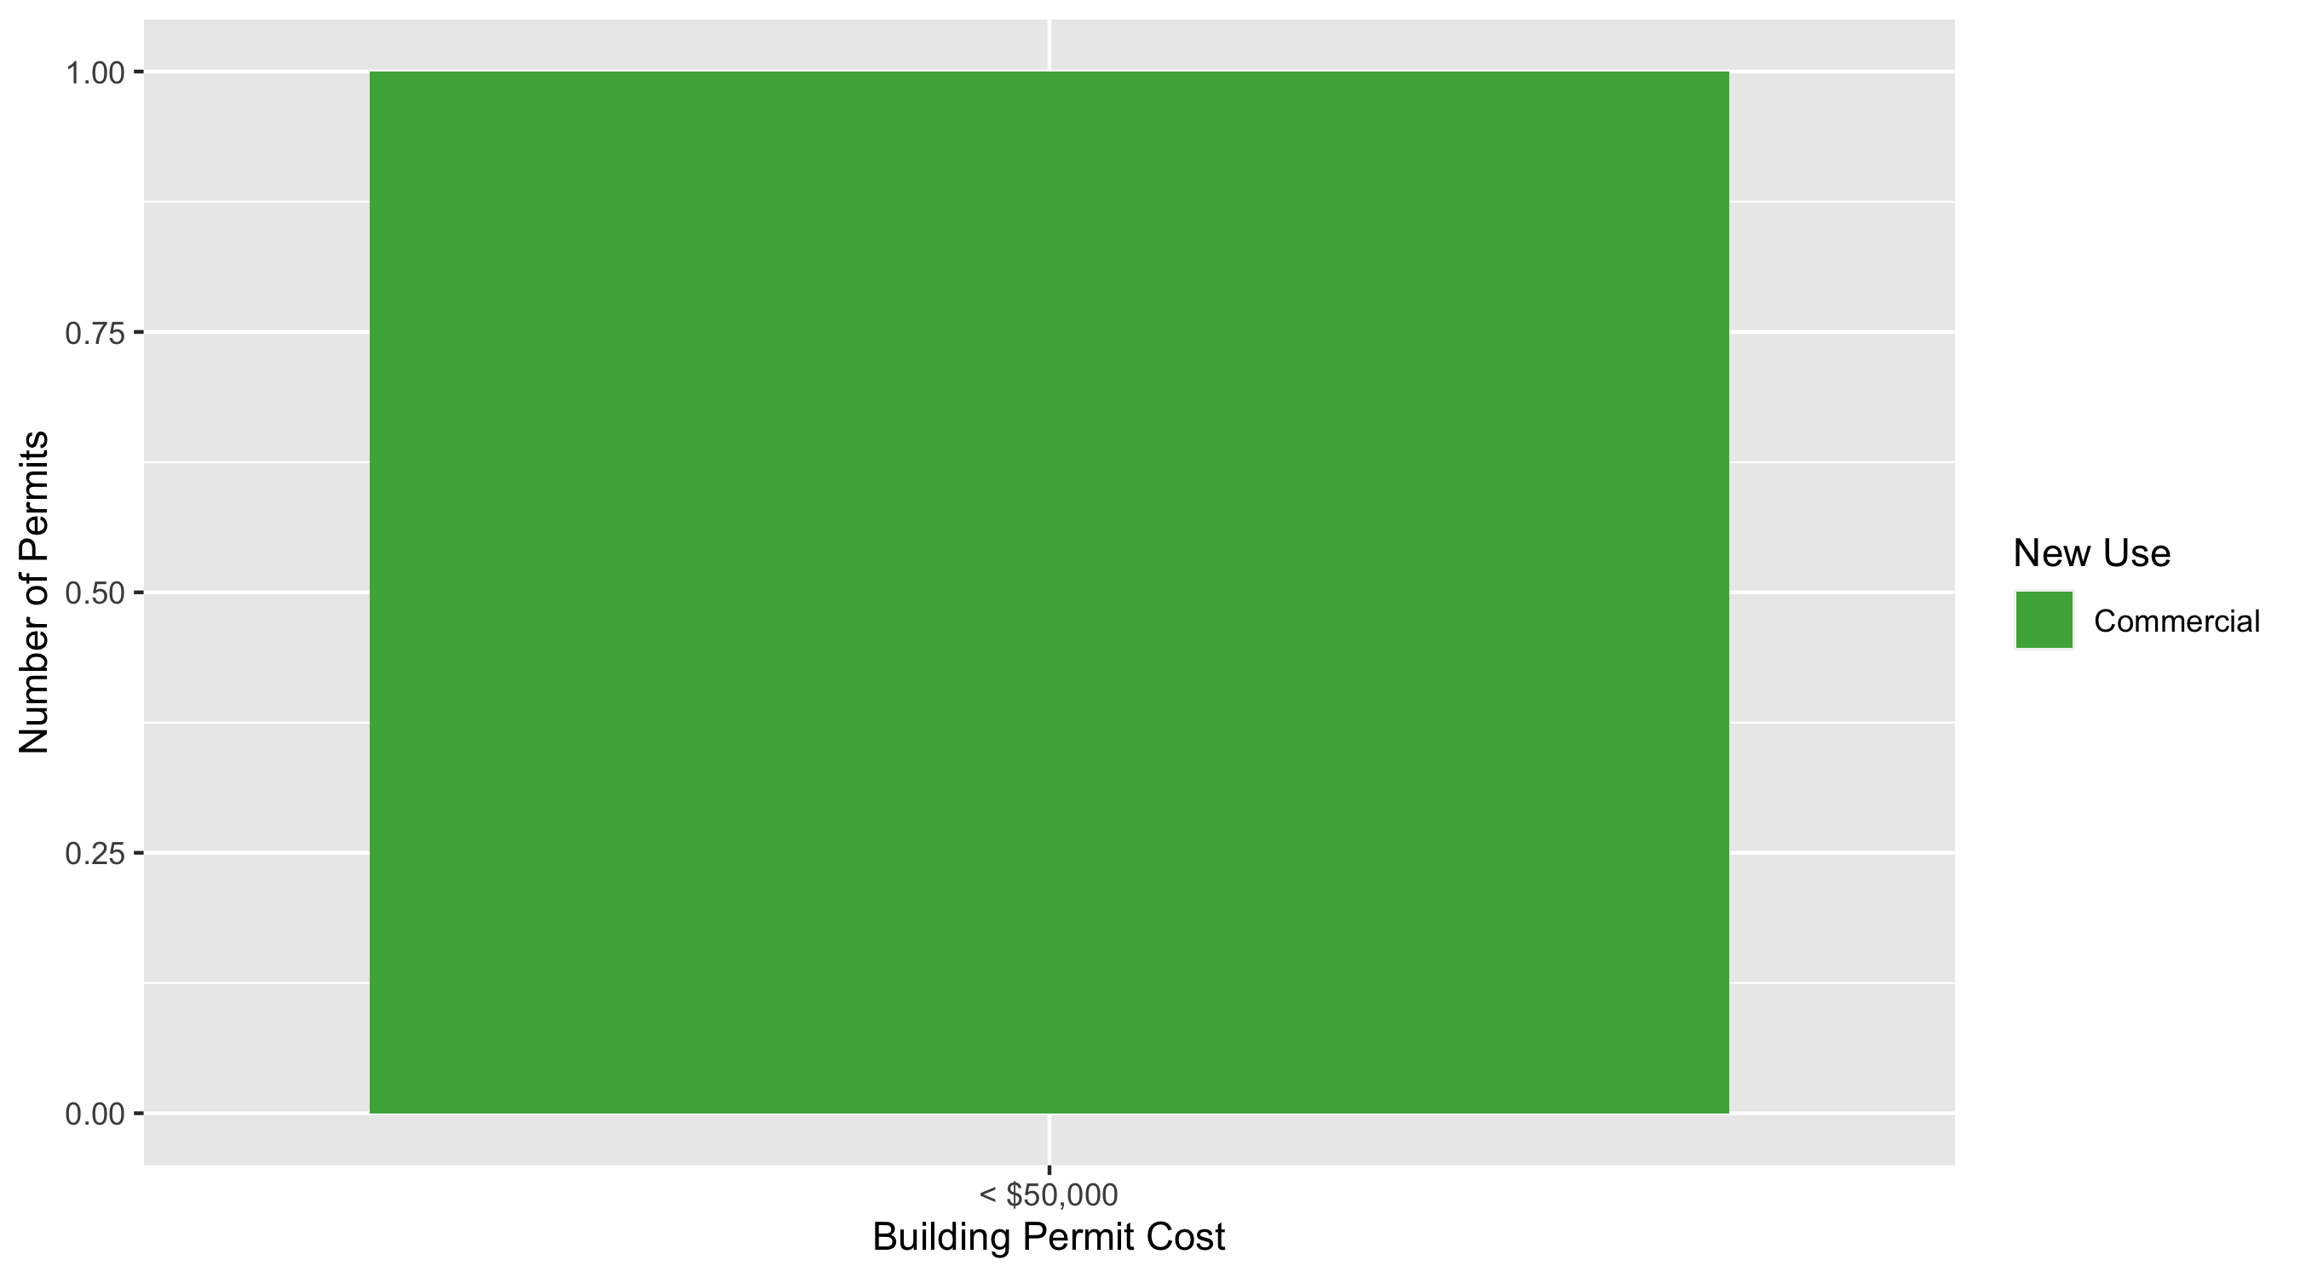
Fountain Park Permit Cost Breakdown

Slide 48
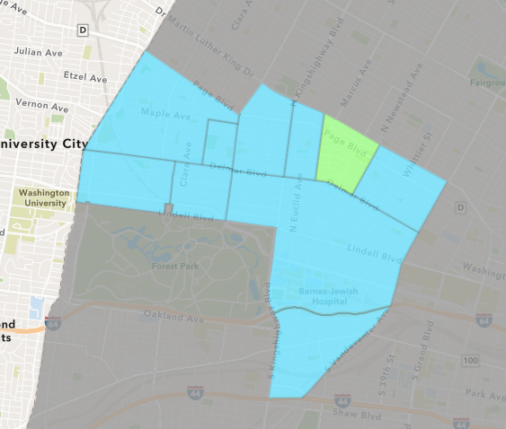
Lewis Place
October 2020 Neighborhood Cost Breakdown
Mean: $6,500
Median: $6,500
Range: $6,500 - $6,500

Slide 49
Lewis Place: Summary Notes
1 building permits in October 2020
0.00% change compared to October 2019 (1 total building permits)
$6,500: Average building permit cost in October 2020
-87.96% change compared to October 2019 ($54,000)
15 total building permits in 2020
87.50% change YTD compared to this time in 2019 (8 total building permits)
$53,197: YTD average building permit cost in 2020
286.54% change YTD compared to this time in 2019 ($13,762)

Slide 50
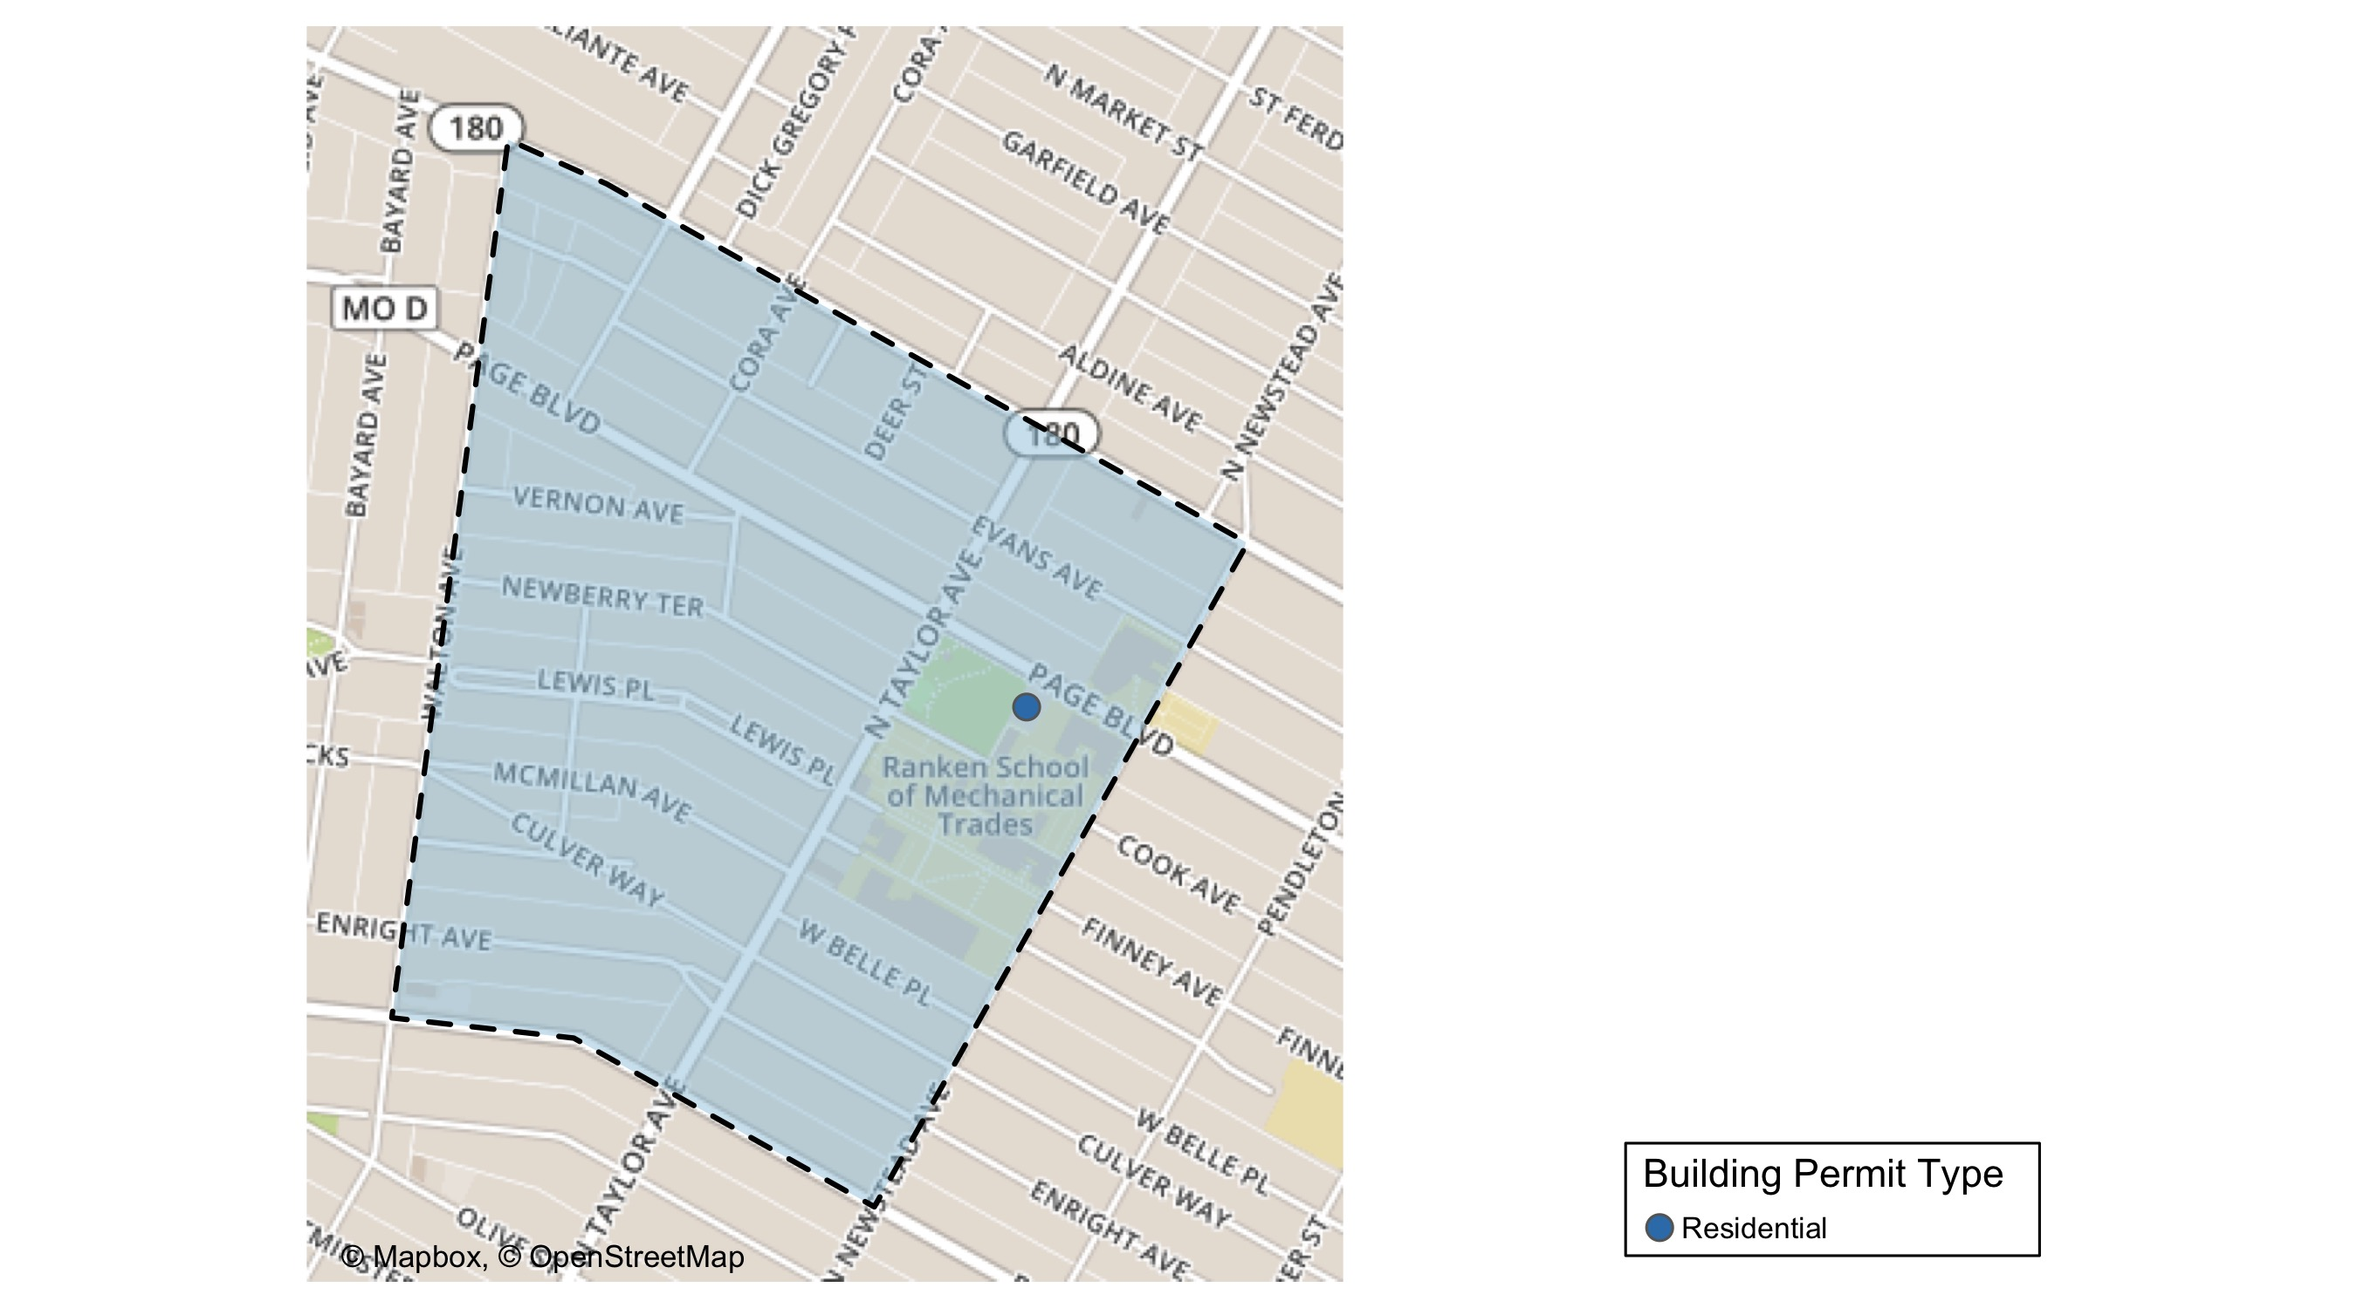
Lewis Place

Slide 51
Lewis Place
October 2020 | October 2020 | October 2020 | October 2020
Permit Use | Average Cost | # of Permits | Total Value of Permits
Commercial | $0 | 0 | $0
Industrial | $0 | 0 | $0
Institutional | $0 | 0 | $0
Residential | $6,500 | 1 | $6,500
Last 6 Months | Last 6 Months | Last 6 Months | Last 6 Months
Permit Use | Average Cost | # of Permits | Total Value of Permits
Commercial | $217,500 | 2 | $435,000
Industrial | $0 | 0 | $0
Institutional | $10,000 | 1 | $10,000
Residential | $43,720 | 8 | $349,760

Slide 52
Lewis Place Individual Permit Breakdown
Owner | New Use | Cost | Address
LOCKETT, JOSEPHINE | Residential | $6,500 | 4557 LEWIS PL

Slide 53
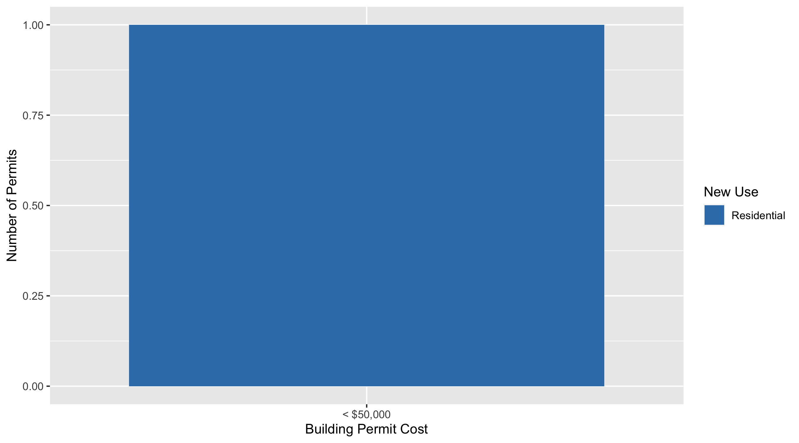
Lewis Place Permit Cost Breakdown

Slide 54
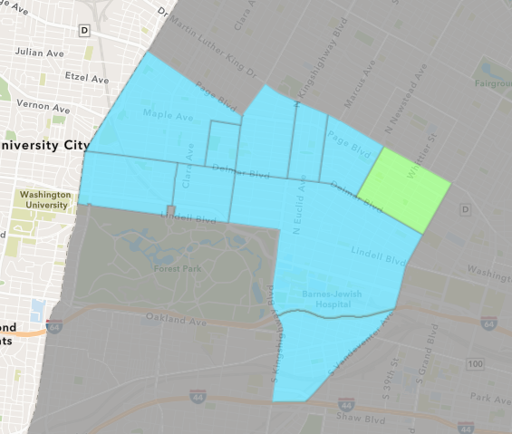
Vandeventer
October 2020 Neighborhood Cost Breakdown
Mean: $29,465
Median: $36,000
Range: $5,023 - $56,000

Slide 55
Vandeventer: Summary Notes
5 building permits in October 2020
66.67% change compared to October 2019 (3 total building permits)
$29,465: Average building permit cost in October 2020
14.06% change compared to October 2019 ($25,833)
16 total building permits in 2020
-48.39% change YTD compared to this time in 2019 (31 total building permits)
$43,503: YTD average building permit cost in 2020
-62.21% change YTD compared to this time in 2019 ($115,115)

Slide 56
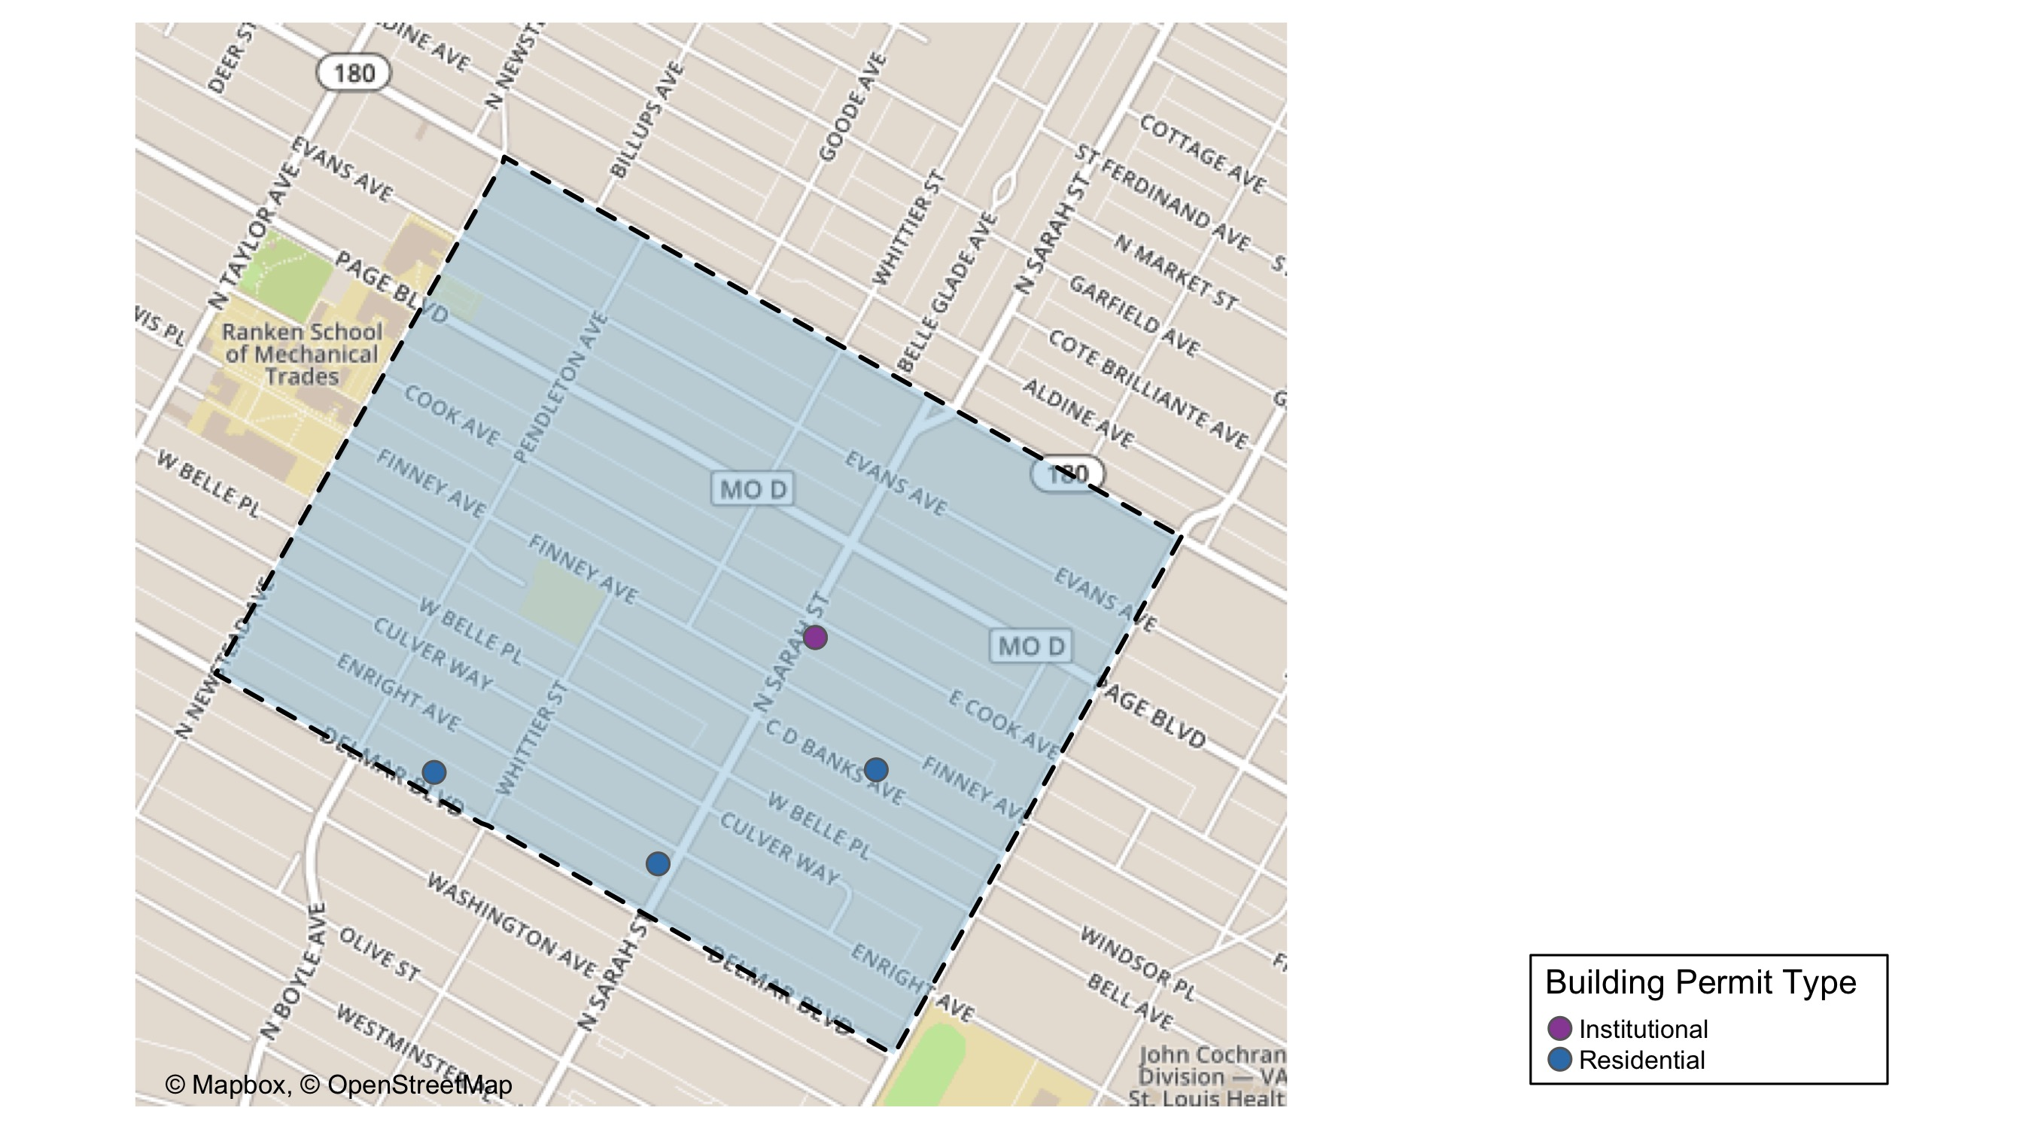
Vandeventer

Slide 57
Vandeventer
October 2020 | October 2020 | October 2020 | October 2020
Permit Use | Average Cost | # of Permits | Total Value of Permits
Commercial | $0 | 0 | $0
Industrial | $0 | 0 | $0
Institutional | $30,512 | 2 | $61,023
Residential | $28,767 | 3 | $86,300
Last 6 Months | Last 6 Months | Last 6 Months | Last 6 Months
Permit Use | Average Cost | # of Permits | Total Value of Permits
Commercial | $0 | 0 | $0
Industrial | $0 | 0 | $0
Institutional | $20,508 | 3 | $61,523
Residential | $44,128 | 9 | $397,149

Slide 58
Vandeventer Individual Permit Breakdown
Owner | New Use | Cost | Address
MOSHEN, REDA | Residential | $40,000 | 4227 DELMAR BLVD
GUARDIAN ANGEL SETTLEMENT ASSOC | Institutional | $56,000 | 1127 N VANDEVENTER AV
ST LOUIS HOUSING AUTHORITY OF THE CI | Residential | $36,000 | 3921 C D BANKS AV
GUARDIAN ANGEL SETTLEMENT ASSOC | Institutional | $5,023 | 1127 N VANDEVENTER AV
GREEN, CAROL | Residential | $10,300 | 4154 ENRIGHT AV

Slide 59
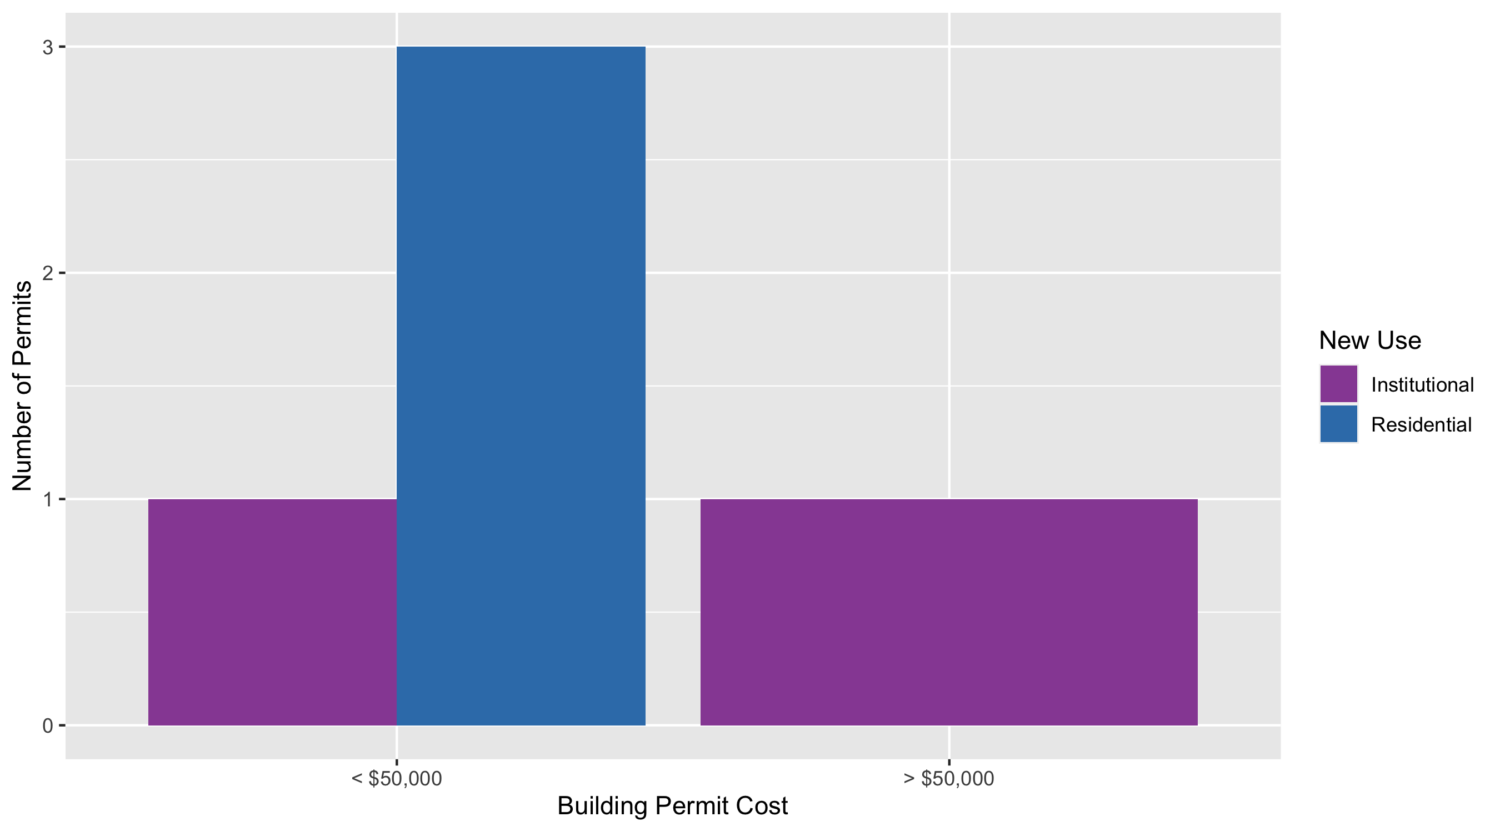
Vandeventer Permit Cost Breakdown

Slide 60
Additional Notes
Data retreived from https://www.stlouis-mo.gov/data/
Building permits with a cost of $0 were dropped
Building permits that were cancelled were dropped
Infinite change indicates 0 permits in the current or previous time period/comparison month so there was a overall increase or decrease

